Slide 1
Quantum Computing Architectures (EE274) Lecture 3
Hiu-Yung Wong
Jan. 30, 2025
hiuyung.wong@sjsu.edu, Office: ENG363
http://www.sjsu.edu/people/hiuyung.wong/index.html

Slide 2
Outline
Linear Algebra
Quantum Gate
Multiple Qubits and Tensor Product

Slide 3
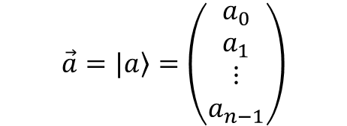
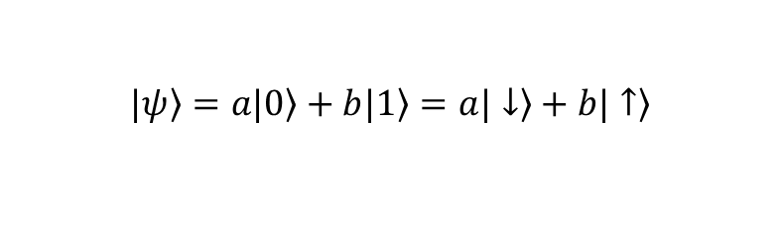
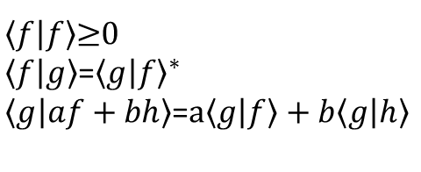
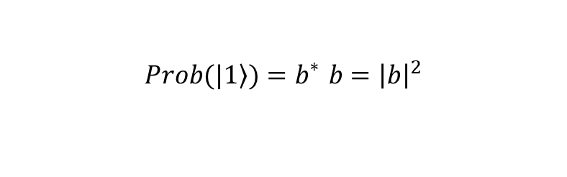
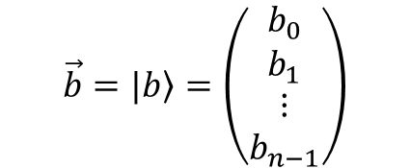
What did we learn in the last lecture?
Hilbert Space (Physics convention)
A complete linear space with inner product obeying:
$\left\langle f | f\right\rangle$≥0
$\left\langle f | g\right\rangle$=${\left\langle g | f\right\rangle }^{∗}$
$\left\langle g | af+bh\right\rangle$=$a\left\langle g | f\right\rangle +b\left\langle g | h\right\rangle$
Inner Product and Bra-Ket notation
$$\vec{a}=|\left.a\right\rangle =\left(\begin{matrix}\begin{matrix}a_{0} \\ a_{1}\end{matrix} \\ \begin{matrix}⋮ \\ a_{n−1}\end{matrix}\end{matrix}\right)$$
$$\vec{b}=|\left.b\right\rangle =\left(\begin{matrix}\begin{matrix}b_{0} \\ b_{1}\end{matrix} \\ \begin{matrix}⋮ \\ b_{n−1}\end{matrix}\end{matrix}\right)$$
$$\vec{a}∙\vec{b}=\left\langle a | b\right\rangle =a_{0}^{∗}b_{0}+a_{1}^{∗}b_{1}+…+a_{n−1}^{∗}b_{n−1}$$
Measurement
$$|\left.ψ\right\rangle =\left.a|0\right\rangle +\left.b|1\right\rangle =\left.a|↓\right\rangle +\left.b|↑\right\rangle$$
Wavefunction collapses in measurement. It will collapse to one of the basis in the measurement. The probability is the norm squared of the coefficient.
$$\left.Prob(|1\right\rangle )=b_{}^{∗}b={\left|b\right|}^{2}$$

Slide 4
Linear Algebra
Chapter 2 of “Quantum Computing Architecture and Hardware for Engineers: Step by Step”
Chapter 3 of “Quantum Computing Architecture and Hardware for Engineers: Step by Step”
Introduction to Quantum Computing From a Layperson to a Programmer in 30 Steps – YouTube
https://www.youtube.com/playlist?list=PLnK6MrIqGXsJfcBdppW3CKJ858zR8P4eP
Lectures 3 - 8

Slide 5


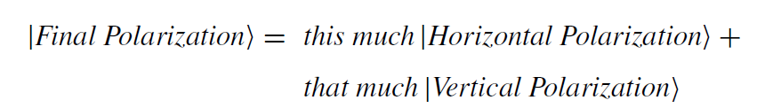
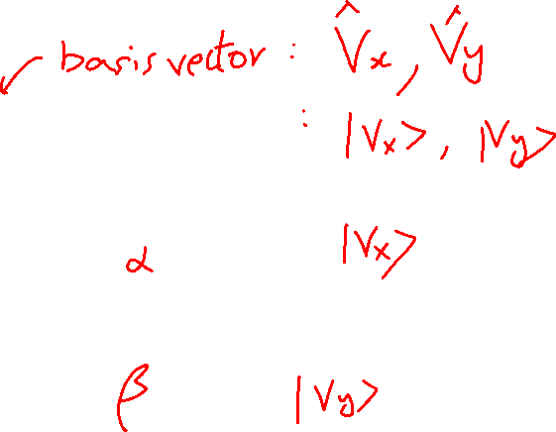
Bra-Ket Notation Recap
Learning outcomes: Everything inside the Bra-Ket can be descriptive
They are all equivalent:

Slide 6
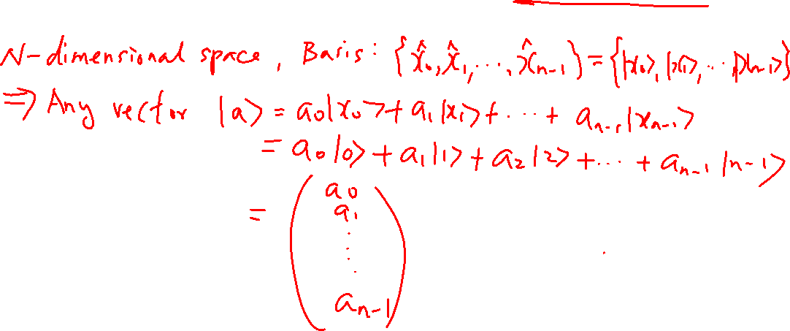
Multi-dimensional Space and Dual Space

Slide 7
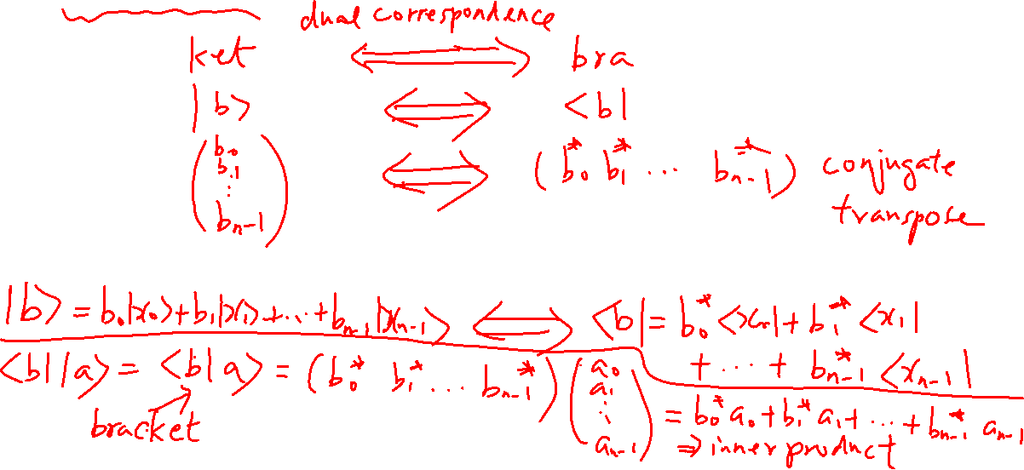
Dual Space and Inner Product
Learning outcomes: Dual space is the “mirror” of the original space.

Slide 8





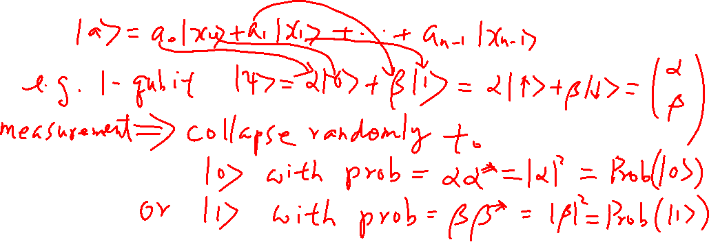
Superposition and Measurement and Wavefunction Collapse
Learning outcomes: Superposition is just a linear combination of some vectors, usually the basis vectors. God plays dice in measurement
$${\left|α\right|}^{2}$$
$$\left.\left|0\right.\right\rangle$$
$$\left.\left|ψ\right.\right\rangle =\left.α\left|0\right.\right\rangle \left.+β\left|1\right.\right\rangle$$
M
$$\left.\left|1\right.\right\rangle$$
$${\left|β\right|}^{2}$$

Slide 9
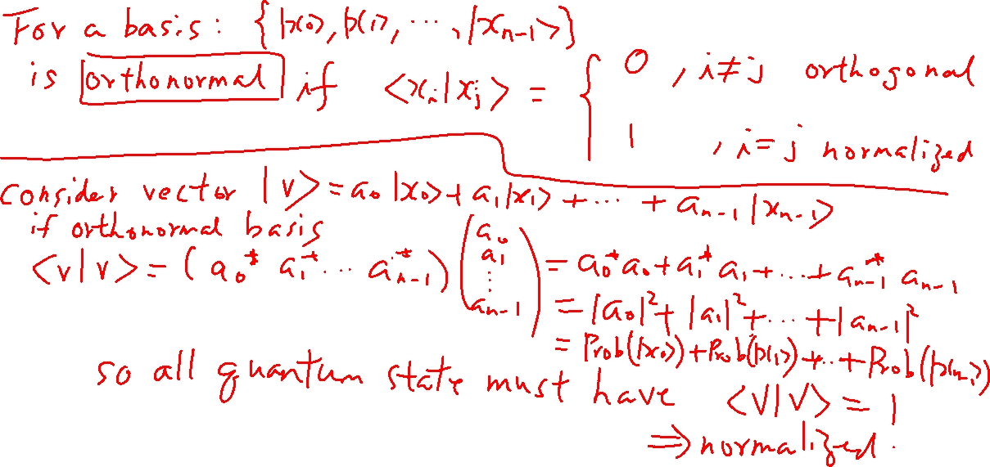
Orthonormal Basis and Normalized Vector
Learning outcomes: The two things make quantum computing math easy.

Slide 10
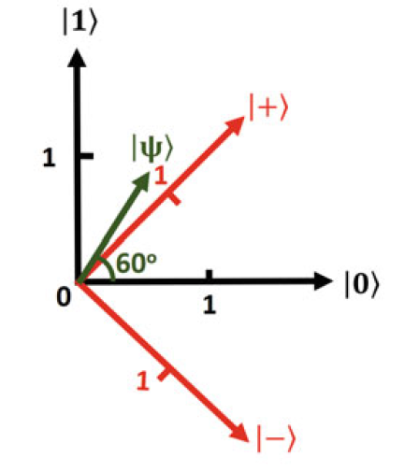
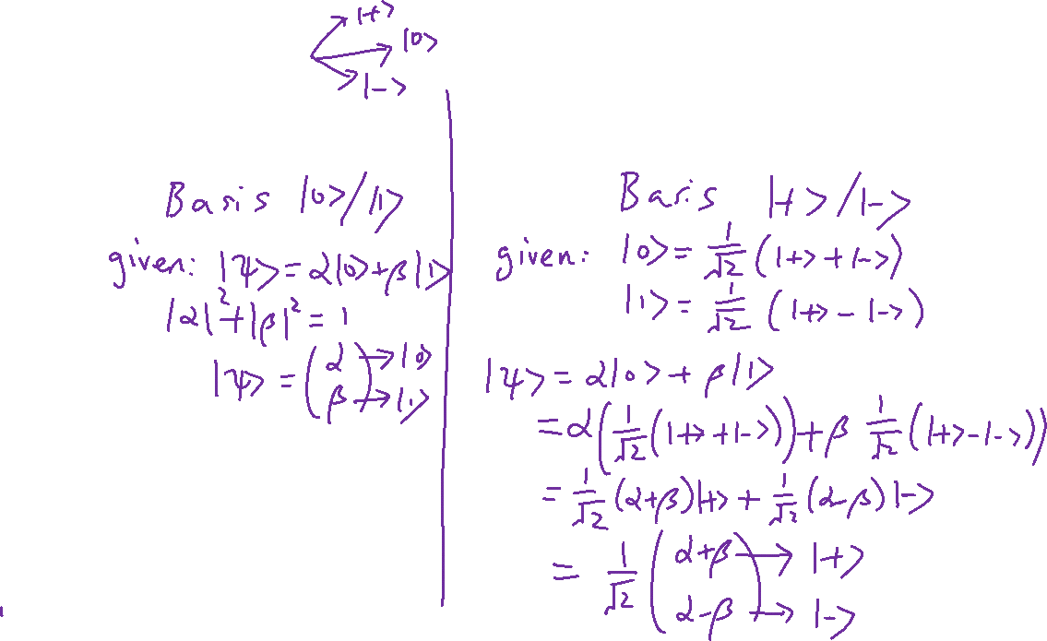
Changing Basis
Learning outcomes: The same vector can be represented in different bases. Learn the Math. Later, we will use transformation matrix.

Slide 11


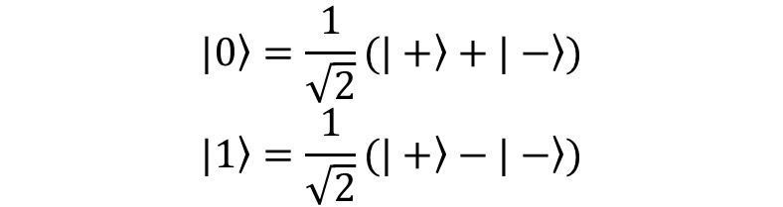

Caveat
In every qubit, we have this relationship. I will explain later. But the 2D picture is fake and is just used as an illustration (turns out to give the right equations).
$$|\left.0\right\rangle =\frac{1}{\sqrt{2}}(\left.|+\right\rangle +\left.|−\right\rangle )$$
$$|\left.1\right\rangle =\frac{1}{\sqrt{2}}(\left.|+\right\rangle −\left.|−\right\rangle )$$
$$|\left.+\right\rangle =\frac{1}{\sqrt{2}}(\left.|0\right\rangle +\left.|1\right\rangle )$$
$$|\left.−\right\rangle =\frac{1}{\sqrt{2}}(\left.|0\right\rangle −\left.|1\right\rangle )$$
Fake representation. This is not how a qubit should be represented.

Slide 12




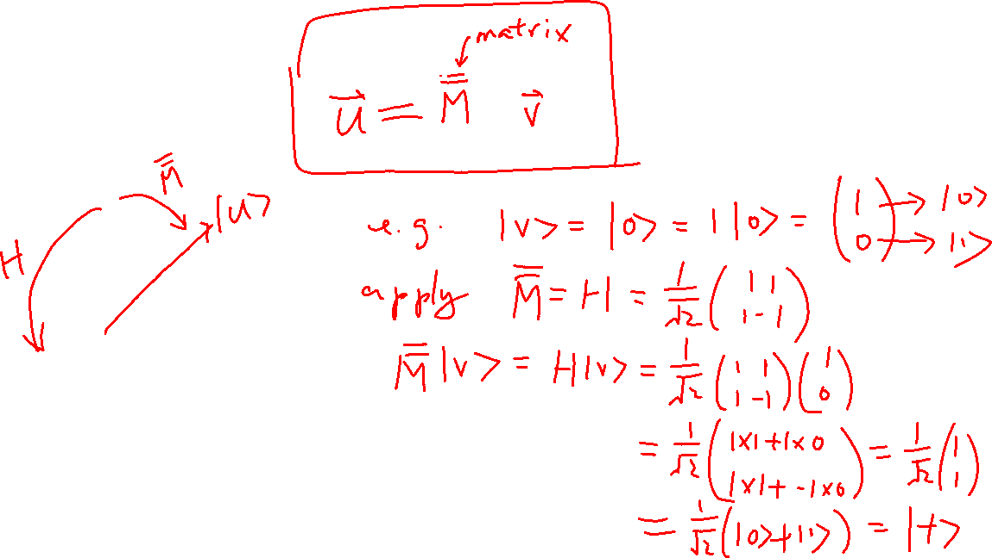

Operators
Learning outcomes: Operator is to rotate the vectors in their space. Operators are matrix.
Bloch Sphere
$$\left|\left.0\right\rangle \right.$$
$$\left|\left.V\right\rangle \right.$$
$$\left|\left.−\right\rangle \right.$$
$$\left|\left.+\right\rangle \right.$$
$$\left|\left.1\right\rangle \right.$$

Slide 13
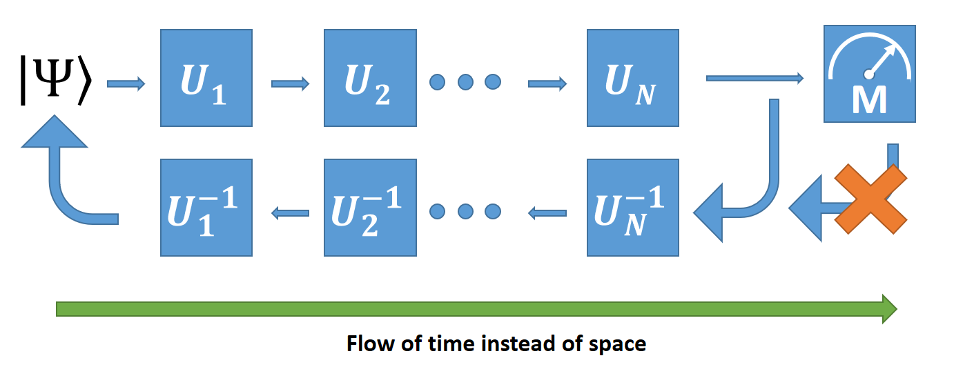
A Quantum Gate is just an Operator
Learning outcomes: Quantum gates are reversible
Each gate is defined by how it rotates the basis state

Slide 14
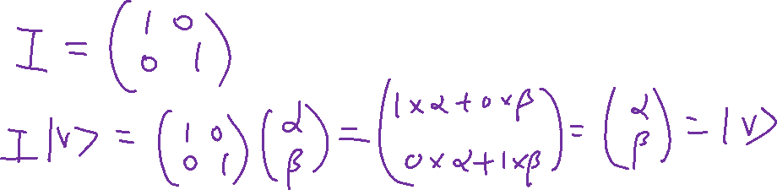
Identity Gate
Learning outcomes: Too trivial but important in the math

Slide 15
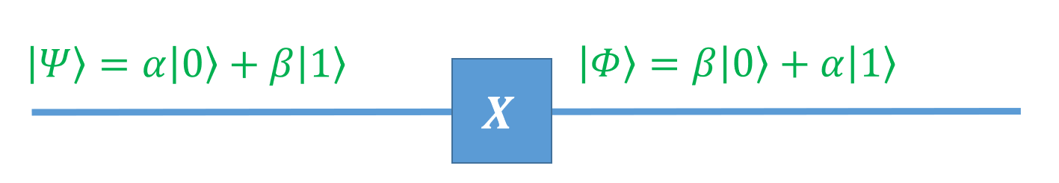
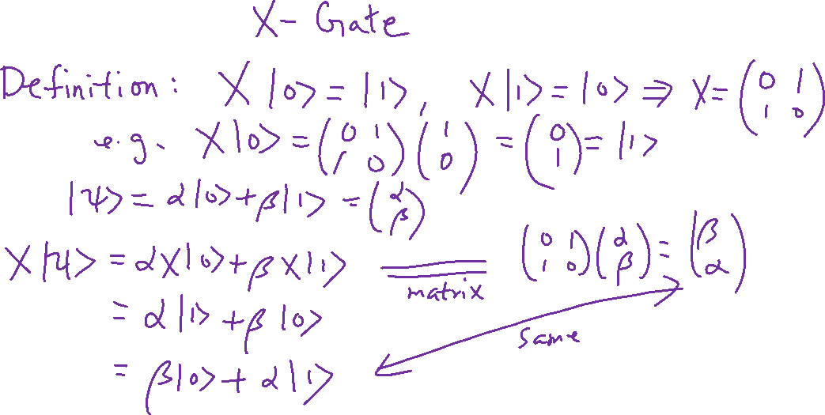
NOT Gate
Learning outcomes: Quantum gate is the same as classical gate if we only care about the basis states.

Slide 16
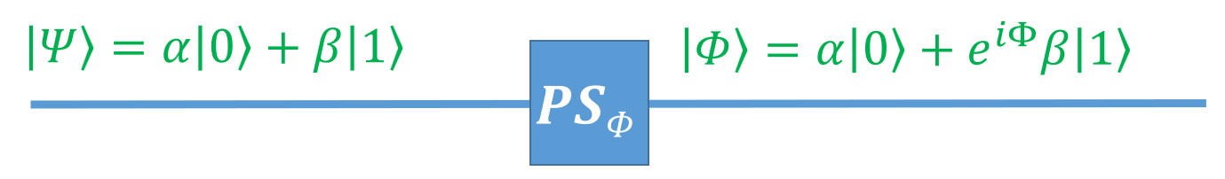
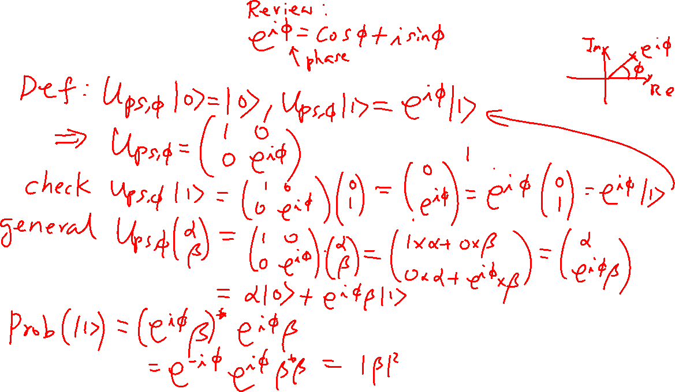
Phase Shift Gate
Learning outcomes: Phase matters; We will use it for interference. Dephasing due to noise is what we want to avoid.

Slide 17

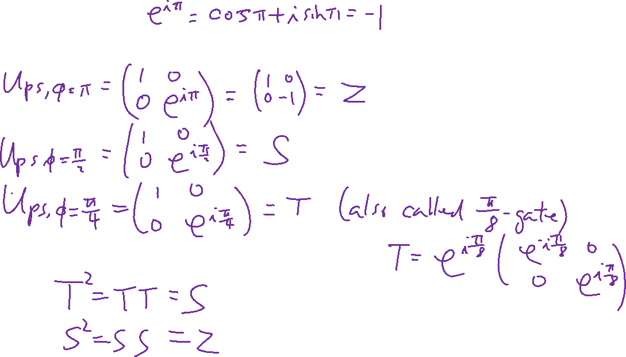
Special Phase Shift Gates
Learning outcomes: Phase matters; We will use it for interference and dephasing due to noise is what we want to avoid
Recall: Universal Sets of Gate:

Slide 18
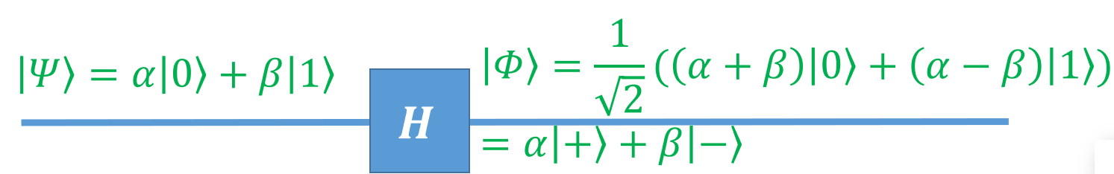
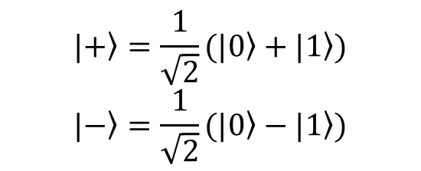
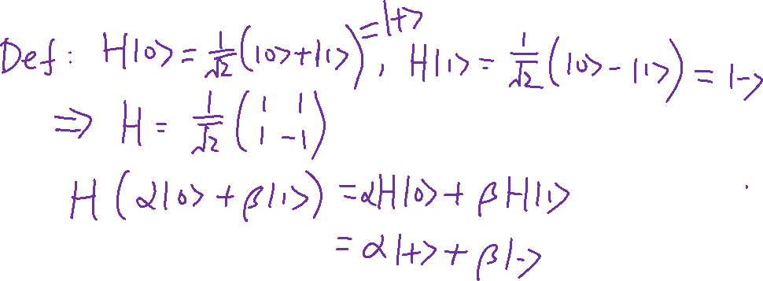
Hadamard Gate
Learning outcomes: No classical counter part! To create superposition.
$$|\left.+\right\rangle =\frac{1}{\sqrt{2}}(\left.|0\right\rangle +\left.|1\right\rangle )$$
$$|\left.−\right\rangle =\frac{1}{\sqrt{2}}(\left.|0\right\rangle −\left.|1\right\rangle )$$
Recall: Universal Sets of Gate:

